Slide 1
Agenda
Week 2
Load instructions for each of these
Not detailed load instructions. Screenshots of what you should see when you load these files.
If you have any questions let me know.
Shot data – this is a CSV file type.
The rest are Excel
Salaries 1000
Records + Salary
Attendance Data
Revenue

Slide 2
Week 2
Instructions for loading data into Tableau. Along with screenshots of what it should look like.
https://peter-tanner.com/moneypuck/downloads/shots_2021.zip
The above will download a zip file.
Move the file to somewhere that relates to BIA 640 Data Visualization.
Unzip it.
There will be a shots_2021.csv
Since you should have already loaded the SuperStore.csv file into Tableau, this is the same thing.
We could use this website that just has players. https://moneypuck.com/stats.htm.
It is a copy and paste but might make life easier.
I show the rest of these files getting loaded into Tableau. I think for Week2, pictures of the data being loaded into Tableau are enough. I will look at the instructions again.
The comments are after the screenshots.
Questions?

Slide 3
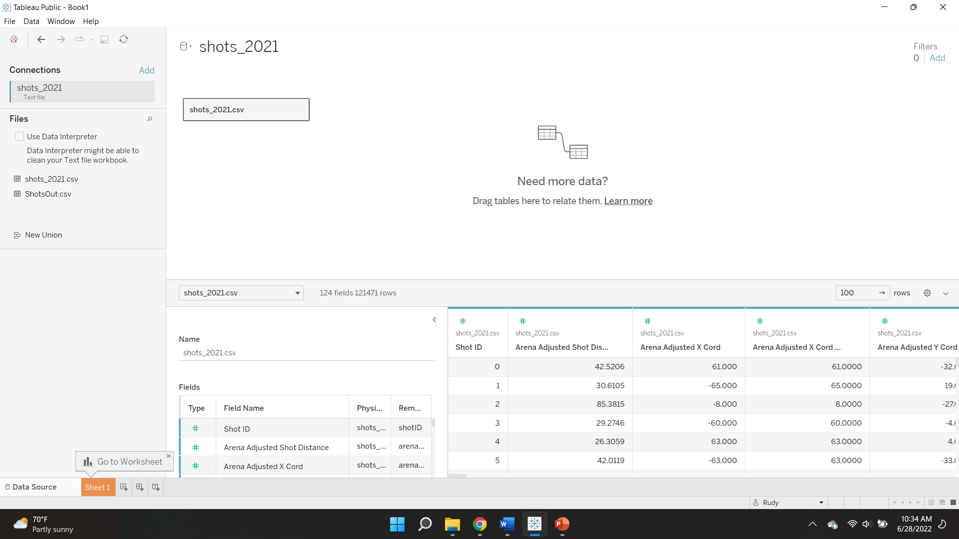

Slide 4
ShotsOut.csv
ShotsOut.csv is a file I create that has what part of the ice the shots and goals take place. Don’t worry about it.
Minor note. CSV files cannot have multiple tabs. Tableau anticipates various files because of that. That is why Tableau lists all the CSV files in a folder.
You will not have that file unless we create it on your machine.
But it does demonstrate how Tableau sees all the file types you have asked for in the folder.

Slide 5
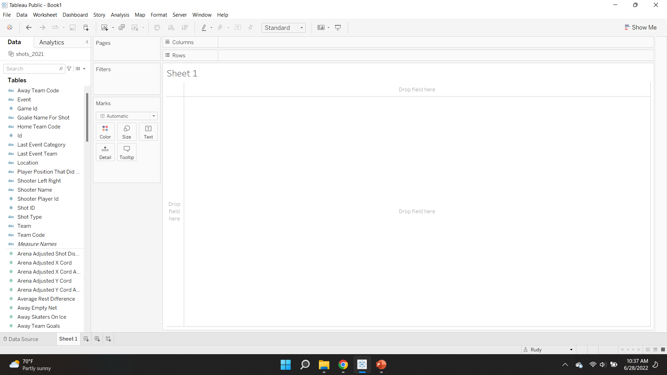

Slide 6
Worksheet
The previous slide shows what it looks like with the data you just loaded.
I going to send along a data dictionary which you could download from MoneyPuck.com.
It defines what each of the fields is for.

Slide 7
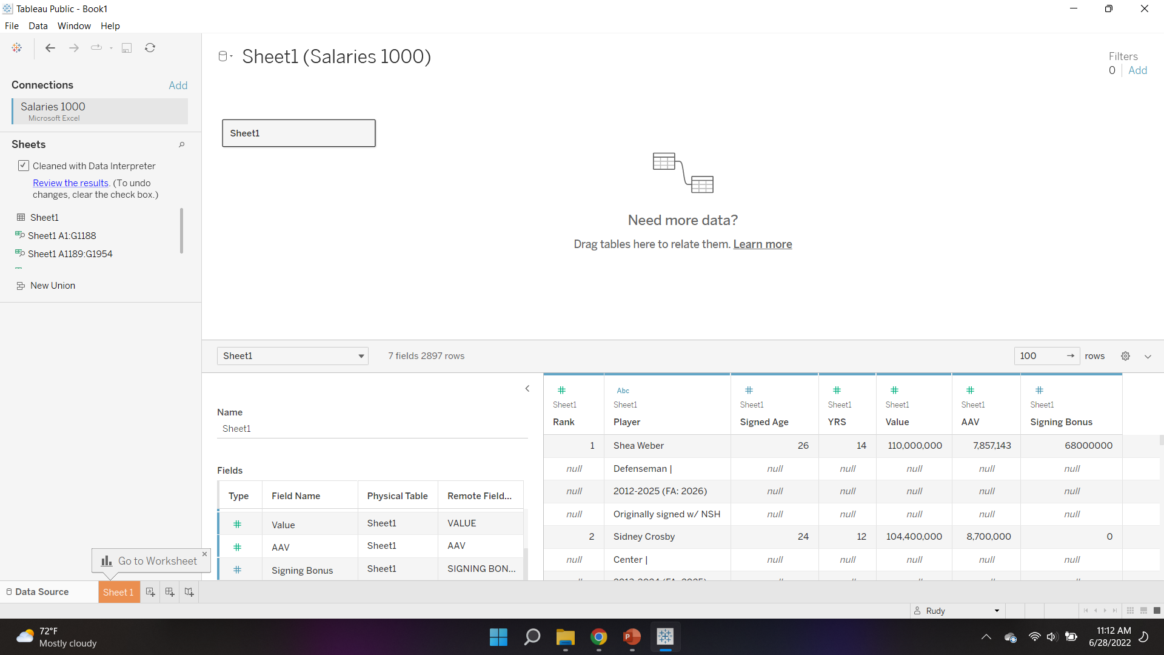

Slide 8
Salaries 1000.xlxs
The previous slide shows what loading the data raw would look like.
We could fix it in Tableau with calculated fields. But it would probably be better to clean the data in Excel.

Slide 9
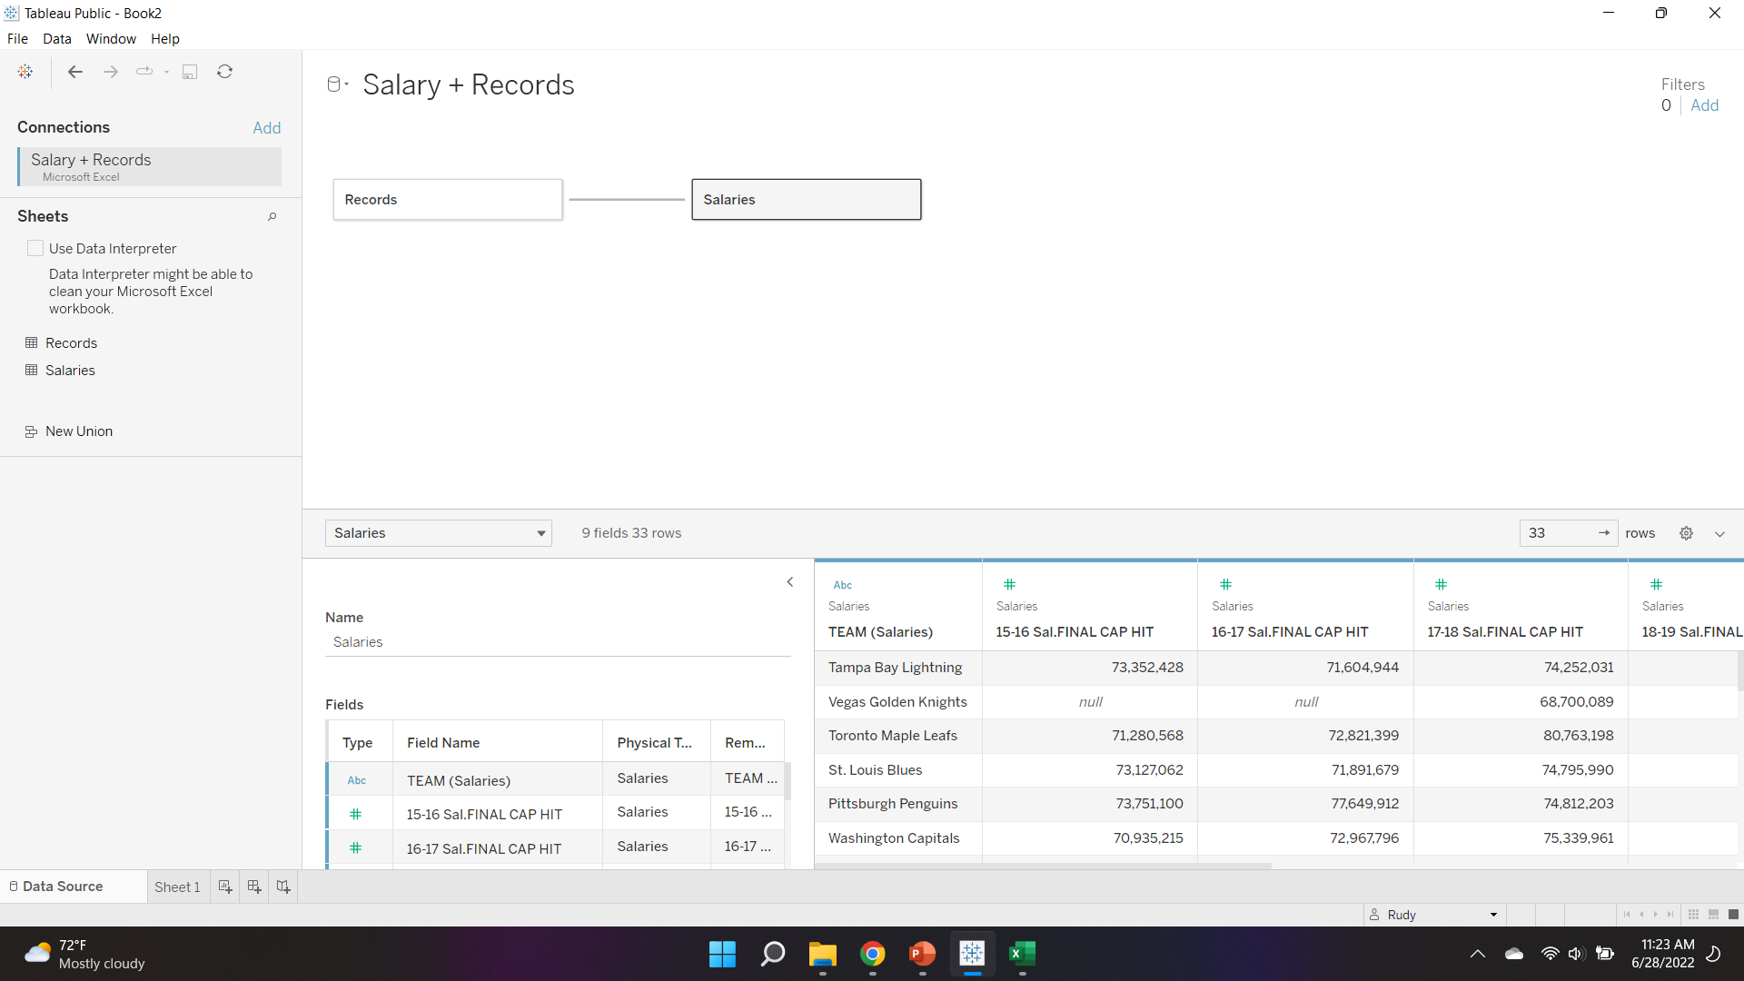

Slide 10
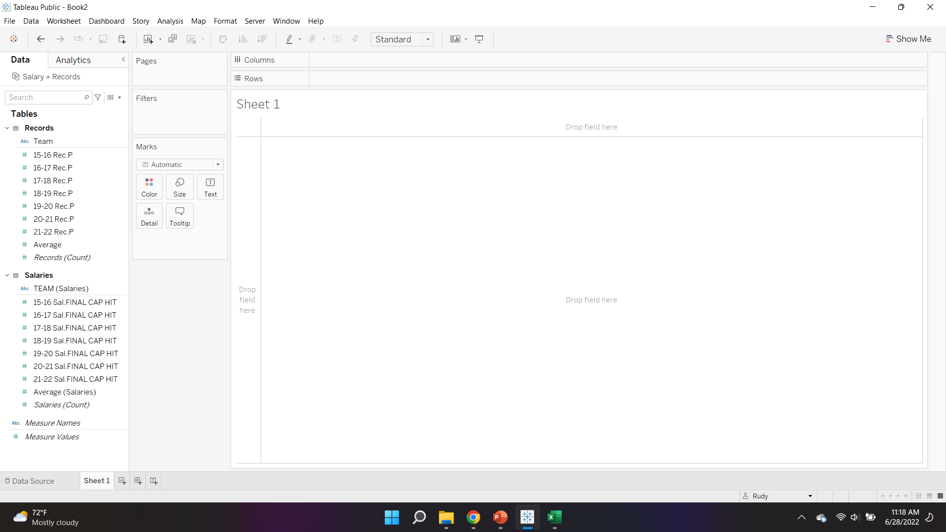

Slide 11
Salary + Records.xlxs
Notice how the two sheets show up. Tableau understands Excel tabs.
Salary should be changed to Salary total by the team. That wasn’t necessary for the previous class.
Things of note:
Probably won’t use this file. It gives us the Salary by team, which might be something we use.
The relationship between the two sheets was not picked up automatically. It had to be created manually.

Slide 12
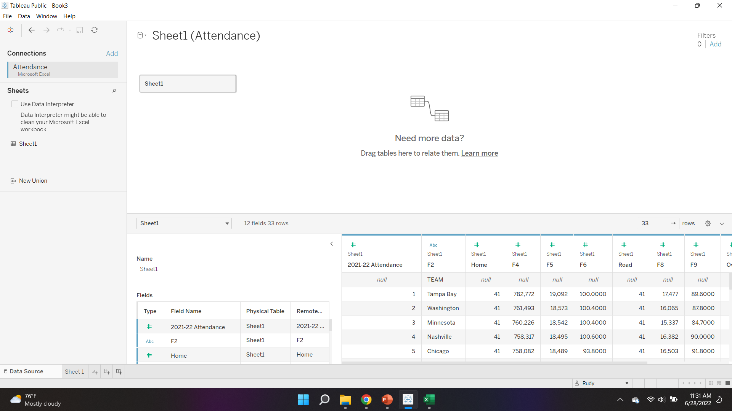

Slide 13
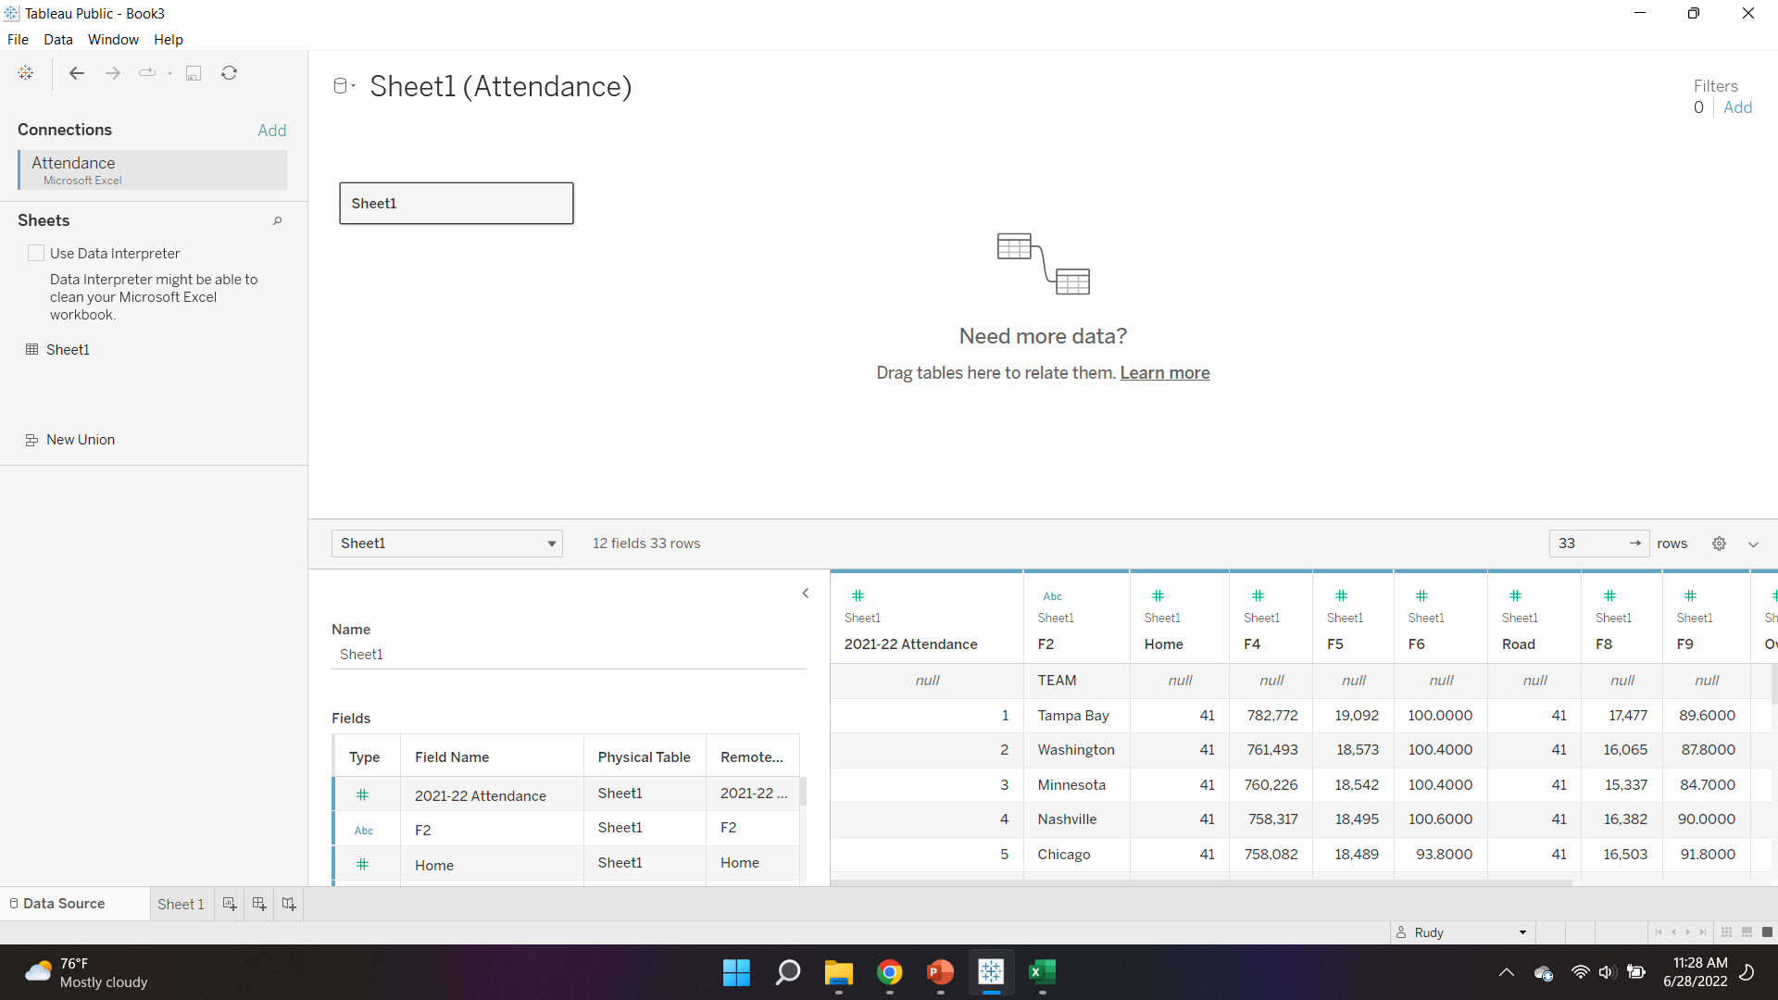

Slide 14
Attendance.xlxs
This file will also require cleaning.
This file is an example of an Excel file created for people.
It is a copy and paste from a website.

Slide 16
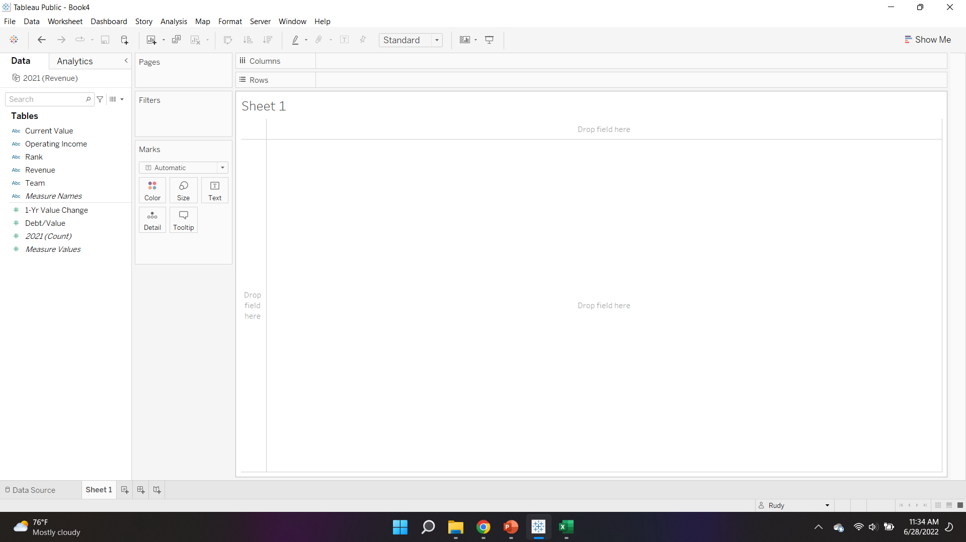

Slide 17
Revenue.xlxs
Note that Tableau understood this spreadsheet. The spreadsheet didn’t have row 1, which confused Tableau.

